Slide 1

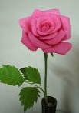
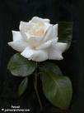

Roses
Red rose = deep and passionate way to say “I love you.”
Pink rose….
  Light pink = gentleness and sometimes sympathy
  Dark pink = gratitude and admiration
White rose = innocence and purity
Yellow rose = deep, true friendship

Slide 2
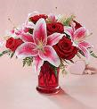
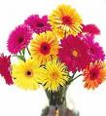
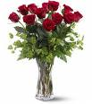

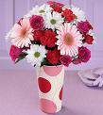

Bouquet (of flowers)

Slide 3
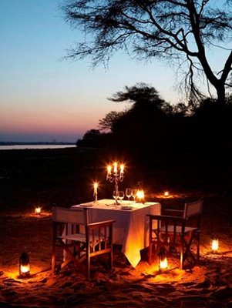
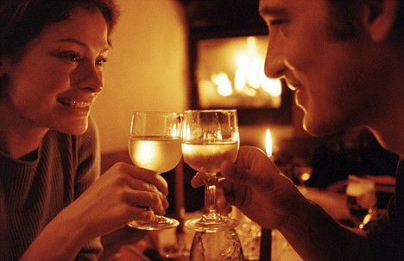
Candlelit

Slide 4


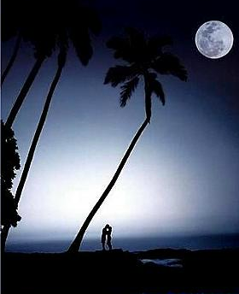
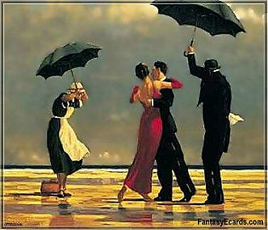
Romantic?

Slide 5
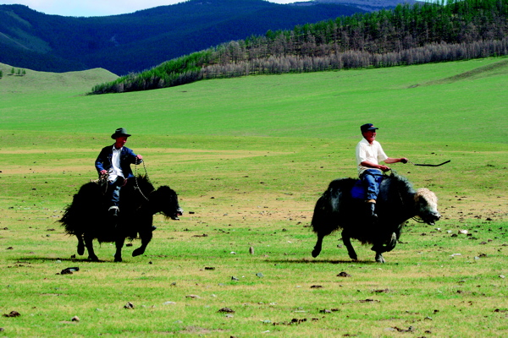

Slide 6


Slide 7


Slide 8
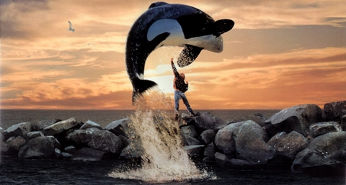

Slide 9

Date. Dating.
These people are dating.
They are probably on a date.

Slide 10
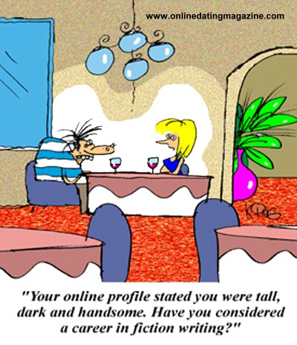
My type, your type…
He’s not my type. = I am not attracted to him.

Slide 11
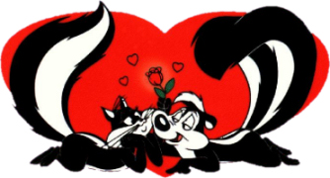
Wow! Is he your type? = wow! Do you like him?
Yes! He is soooo my type. = Yes, DEFINITELY.

Slide 12
Rejecting…
…is when the girl says “no”.
(Then maybe there is sadness but the man will just have to get over it.)

Slide 13
Sample rejection letter
Dear Bob,
thank you soooo much for the chocolates... they are the best! not even joking. and the roses are lovely!
about saturday, and other days for that matter as far as going out and stuff, i just don't feel the same way. i'm not interested in anything more than just friendship with you. i'm sorry if i wasn't very clear about it and stuff. thank you for the invitation though!
see you later!

Slide 14
Accepting…
…is when the girl says “yes”.
(And everyone lives happily ever after.)
Unless………….

Slide 15
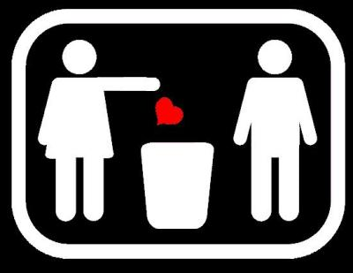
Breaking up
Two people stop dating ☹

Slide 16
Adjectives of beauty…
Pretty
Beautiful
Gorgeous
Hot
Stunning

Slide 17
Terms of endearment…
Valentine – (probably only for Valentine’s Day)
Love (very strong)
Girlfriend/Boyfriend
Darling
Dearest
Honey
Sweetie

Slide 18
Other terms…
“the bomb” = the best / coolest
“Fine” = good-looking (usually referring to the body)
Smokin’ = attractive (usually referring to the body)
Kickin’ = attractive (usually referring to the body again)
Love at first sight = knowing you’re in love just by seeing the other person. (can it be true?)
You rock my world = you make my life so special
Go out with (someone) = to date (someone)
Digging you = attracted to you

Slide 19
Booger … wait what?
Heaven = the most perfect place (in romance, this is where beautiful people come from)
angel = a beautiful, nice girl or boy
Steal my heart = I’m so in love with you that you’ve taken my heart away
Sweep off your feet = I’m floating with happiness because of your love

Slide 20
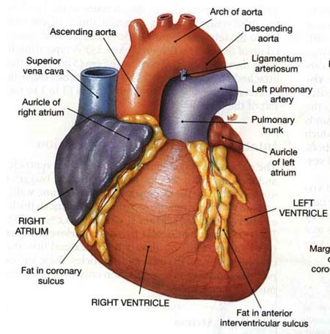
Let’s Review…

